Slide 1
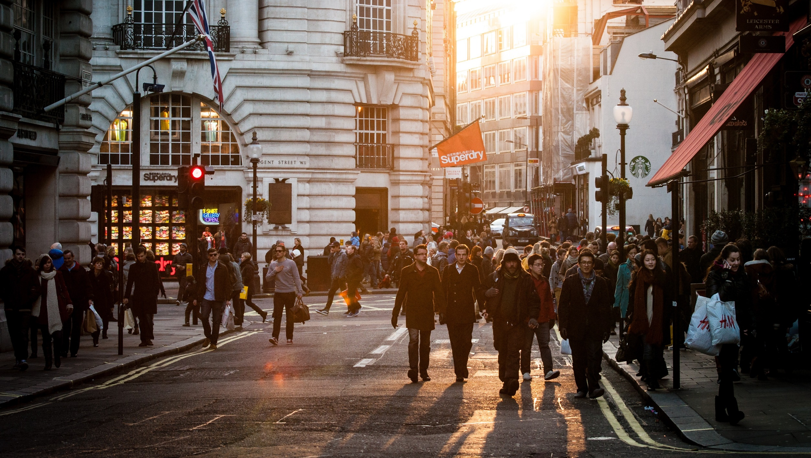
ANGLICKÝ
JAZYK
Ing. Kamila Tišlerová, Ph.D.

Slide 2
Content
Block 1 |  | Block 2
Grammar: Time Clause | 1 hour | Project „Visit London“
Topics: Travelling |  | Travel formats – couchsurfing, house sitting, home swap, Worldee, Airbnb | 1 hour
Conversation on own travel experience | 1 hour | Tourism in London | 1 hour
Vocabulary, articles on travelling | 1 hour | Personalized travel plan | 1 hour
Searching for flight tickets | 1 hour | Presentation | 1 hour
Vysoká škola ekonomie a managementu

Slide 3
Grammar

Slide 4
Time Clauses
Vedlejší časové věty
after
as soon as
before
till, until
when
whenever
while

Slide 6
Samples
When I get home, I will send you a message.
As soon as I arrive, I will let you know.
After I write my essay, I will help him.
Before I go to school, I will call you.
As soon as the film starts, I will turn off my mobile phone.
Before I leave my flat, I will close the window.

Slide 7
I'll come back home and I'll do it. Vrátím se domů a udělám to.
I'll do it when I come back home. Udělám to, až se vrátím domů.
You'll push this button and the door will open. Stiskneš tento knoflík a dveře se otevřou.
As soon as you push this button the door will open. Jakmile stiskneš tento knoflík, dveře se otevřou.
Don't stand up. I'll tell you. Nevstávej. Řeknu ti.
Don't stand up till (until) I tell you. Nevstávej, dokud ti neřeknu.
You'll need my car. Take it. Budeš potřebovat moje auto. Vezmi si ho. Whenever you need my car you can take it. Kdykoliv budeš potřebovat moje auto, můžeš si ho vzít.

Slide 8
https://www.focus.olsztyn.pl/en-english-grammar-time-clauses-exercises.html
Let´s practice

Slide 9
Classwork: prepare your own funny and memorable sentences:

Slide 10
Travel experiences
Have you ever been to…?
I have been to…..
www……travel stories
https://www.youtube.com/watch?v=89eKNB2Ujw0&ab_channel=BuzzFeedVideo

Slide 11
https://www.gym-karvina.cz/userfiles/231/travelling_-_vocabulary.pdf
Travel vocabulary

Slide 16
Searching for flight tickets
Arrival, Departure, Destination
Check-in
Baggage: check-in bag, cabin bag
Hidden fees
Fast track
Gate, go to gate
Boarding
Itinerary

Slide 17
Planning trip - LONDON

Slide 18
https://www.youtube.com/watch?v=464puoD09dM
Watch and discuss

Slide 19
What is it? Explain it to your classmates (presentation)
Couchsurfing
Air bnb
Home swap (gumtree.com – property)
Worldee,…
Home/pet sitting

Slide 20
London trip
Choose one performace, which one, why, something about it. Where is the theatre? How can I get there? How much is the ticket? What time it starts?
Choose a voluntary program in the Science Museum. Which one? Why? What time? How to get there?
How can I get from the Stansted airport to the centre? (Victoria coach station)
What kind of ticket shall I buy for:
- one way in the very center (1-2 zone)
- a week ticket for all zones
Does it worth to visit „Tower“? Why yes, why not?
Describe the HMS cruizer and decide to visit (or not)

Slide 21
Present your own travel plan

Slide 22
Presentation

Slide 23
Thank you for
your attention
Ing. Kamila Tišlerová, Ph.D.

