Slide 1
Anglický
jazyk
Bc. Zuzana Slavíková

Slide 2
Souhrn minulé lekce
Homework check
2B Writing discussion
Superlatives
Comparatives
What type of words do we use when comparing people/places/… and what type do we use when comparing actions?

Slide 3
Dnešní lekce

Slide 4
Obsah lekce
3B
Grammar: articles | 05
Grammar: pop quiz | 06
Pronunciation | 07
Vocabulary | 08
Reading | 09
Speaking | 10
Practical English: episode 2 | 11

Slide 5
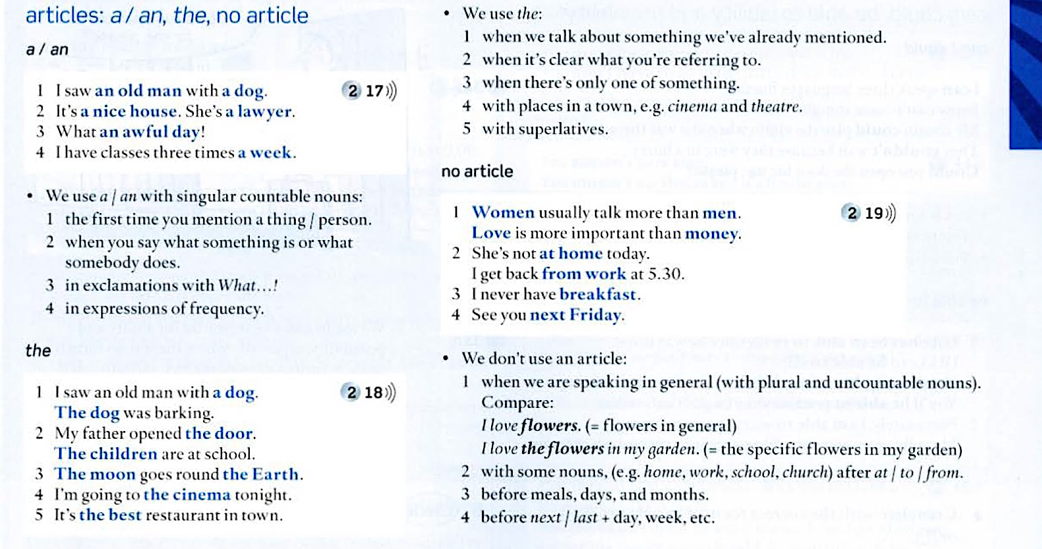
3B Grammar: articles
Student’s Book: p. 137

Slide 6
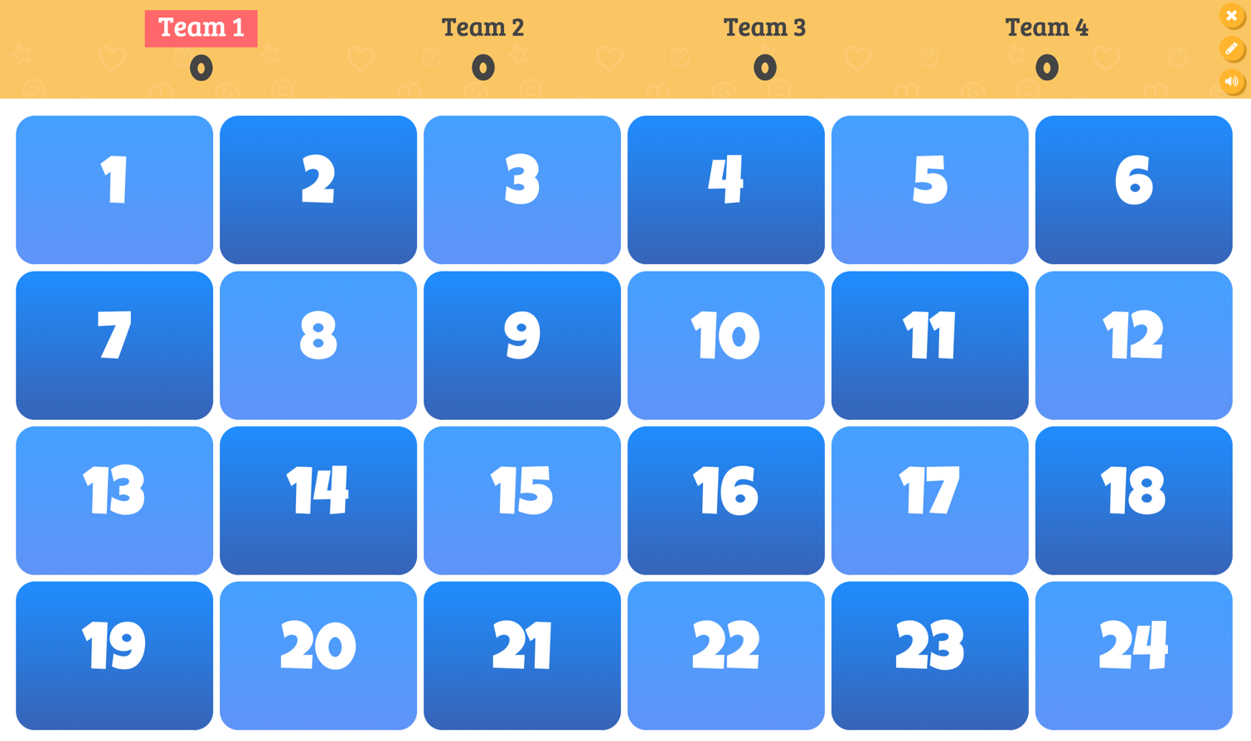
3B Grammar: pop quiz

Slide 7
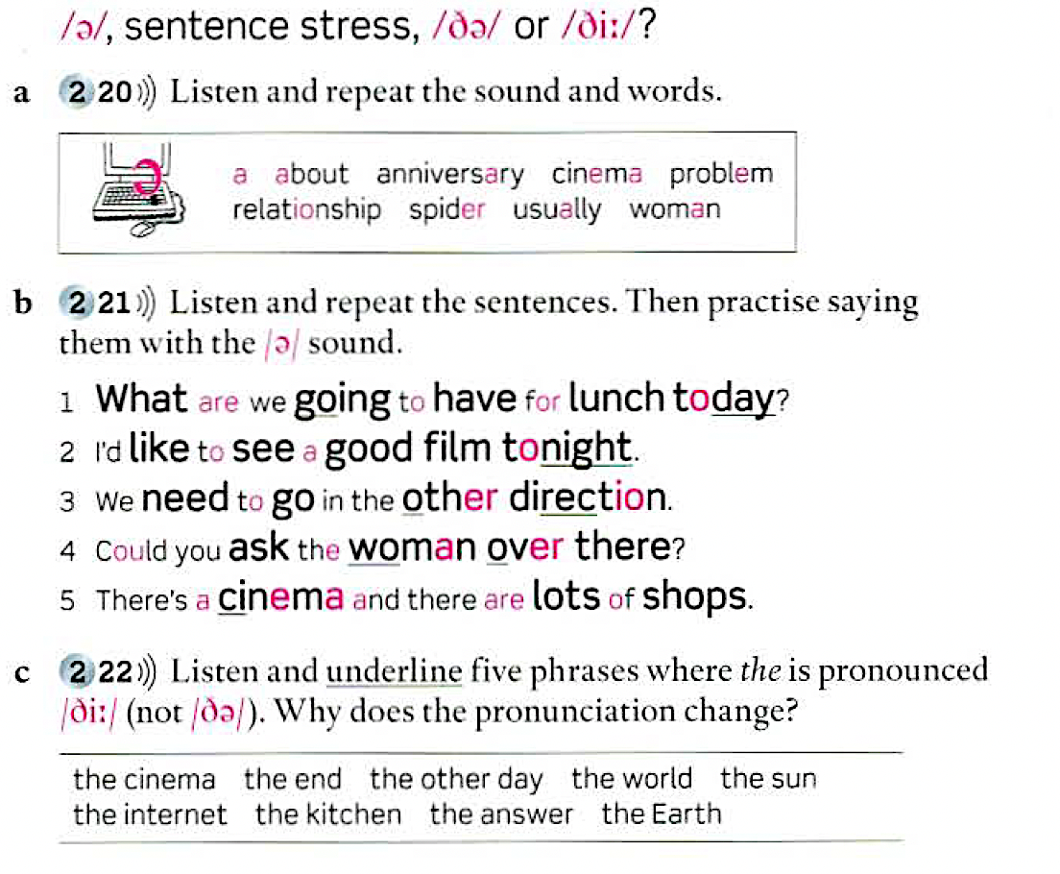
3B Pronunciation

Slide 8
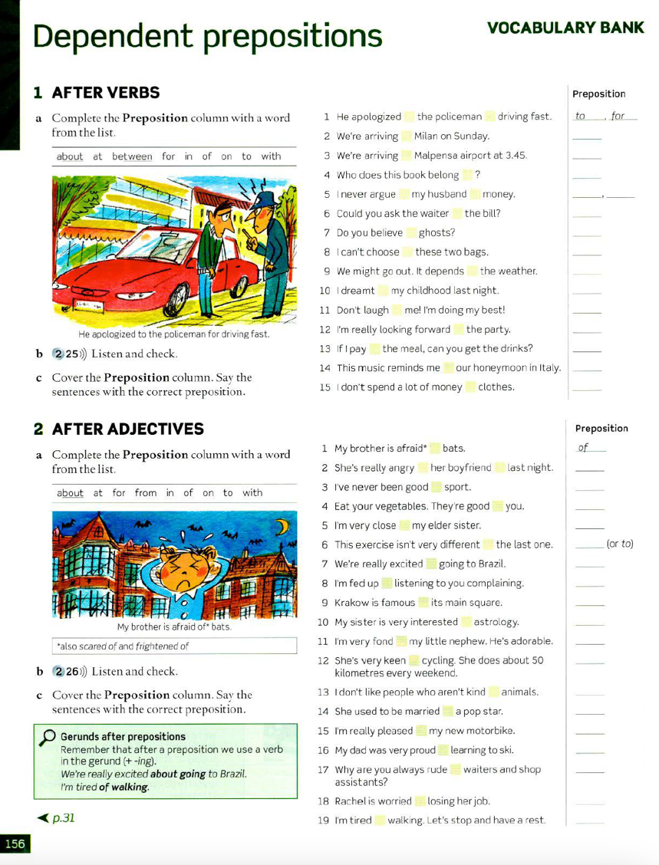
3B Vocabulary
dependent prepositions
prepositions that depend on or must follow a particular verb, noun, or adjective.
in another way: when you use certain verbs, nouns, or adjectives, they are followed by a specific preposition

Slide 9
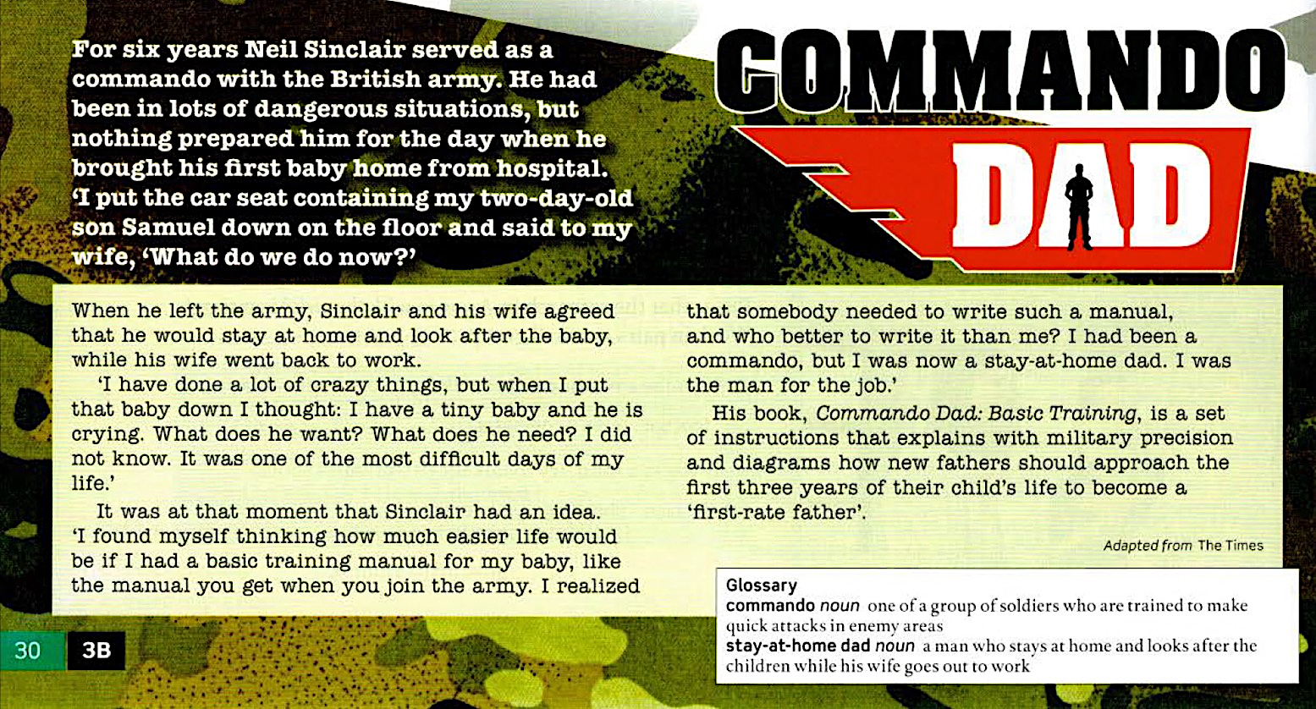
3B Reading

Slide 10
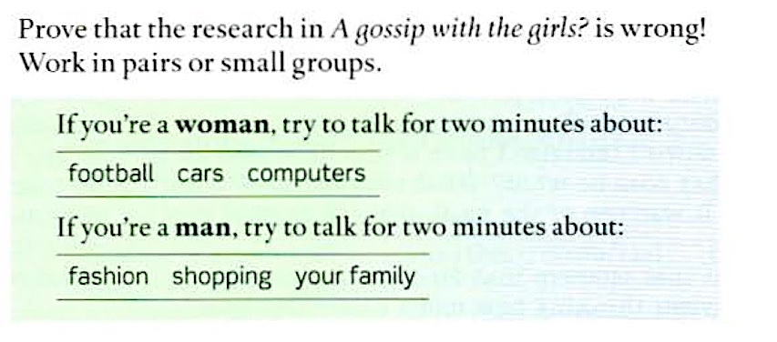
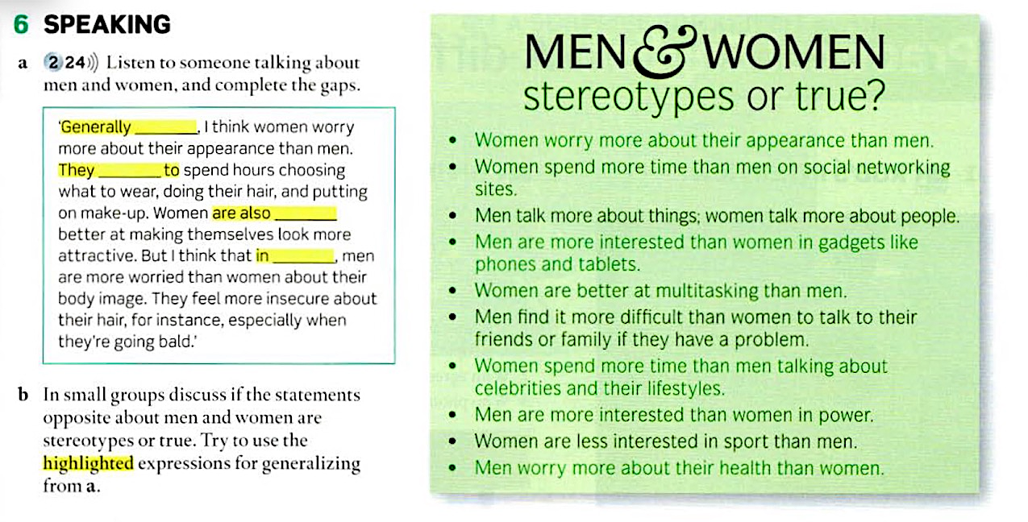
3B Speaking

Slide 11
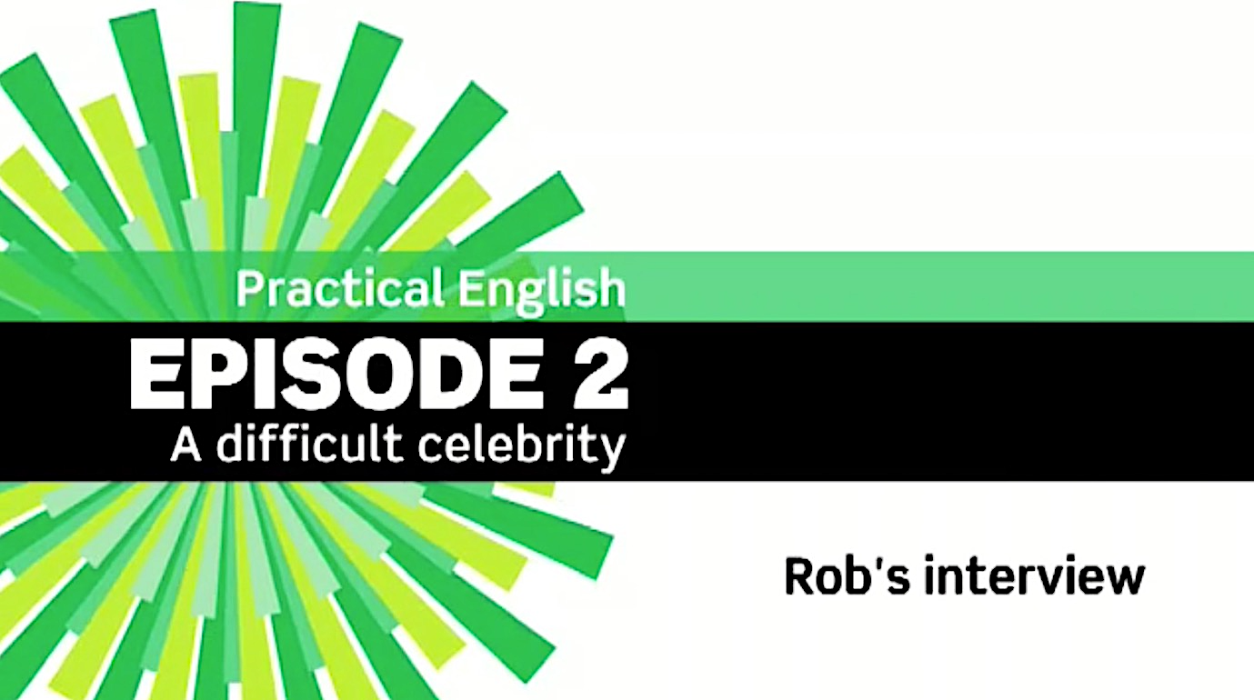
Practical English: episode 2

