Slide 1
Anglický
jazyk
Bc. Zuzana Slavíková

Slide 2
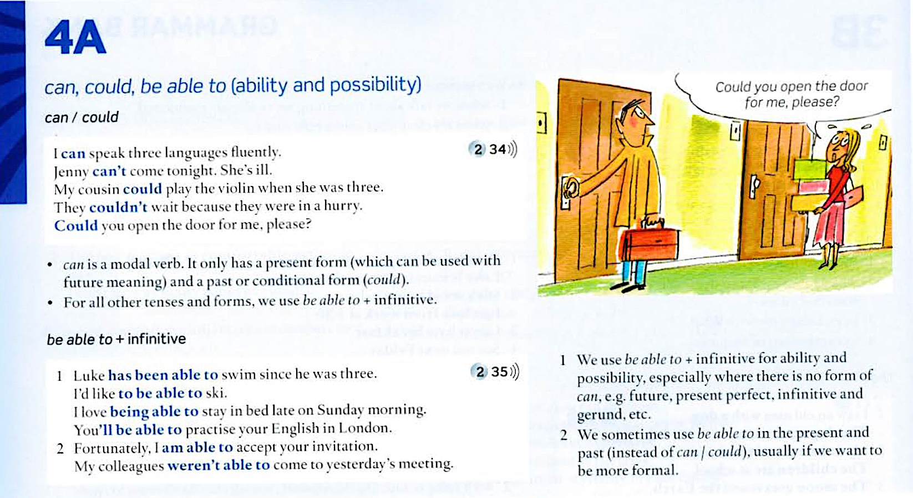
4A Grammar: can, could, be able to
Student’s Book: p. 138

Slide 3
4A Vocabulary

Slide 4
Dnešní lekce

Slide 5
Obsah lekce
4B
Grammar: modals of obligation | 06
Pronunciation | 08
Reading | 09
Listening | 10
Speaking | 11

Slide 6
4B Grammar

Slide 7
4B Grammar

Slide 8
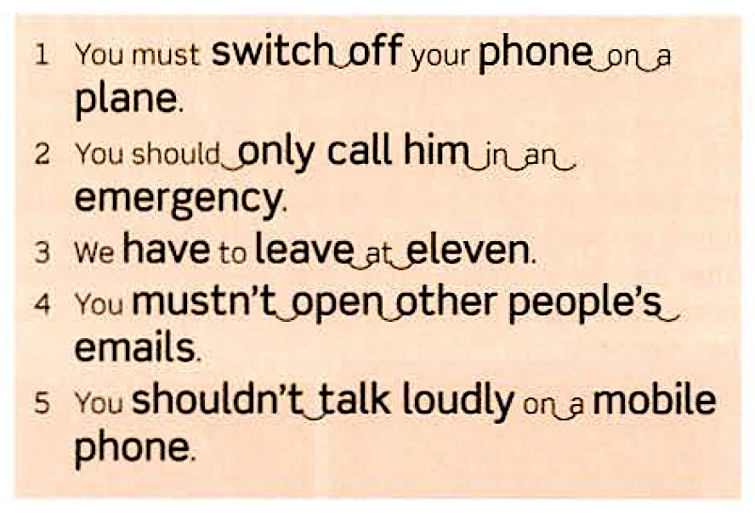
4B Pronunciation

Slide 9
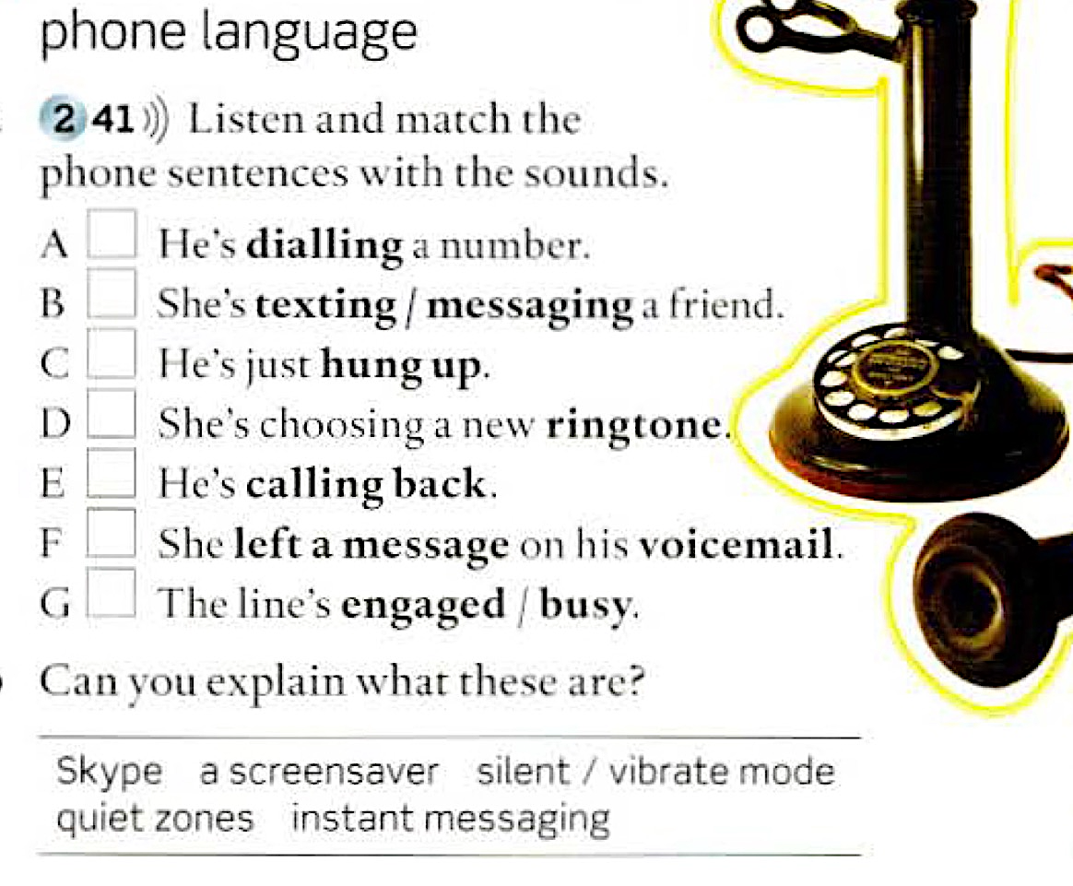
4B Vocabulary

Slide 10
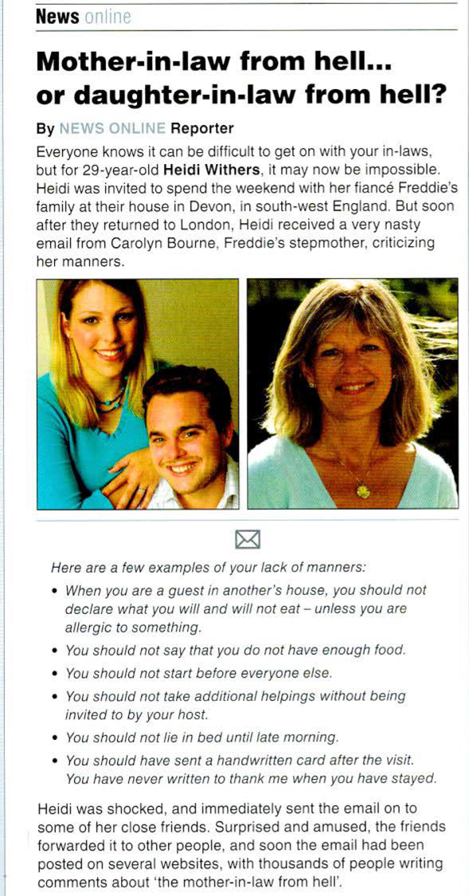
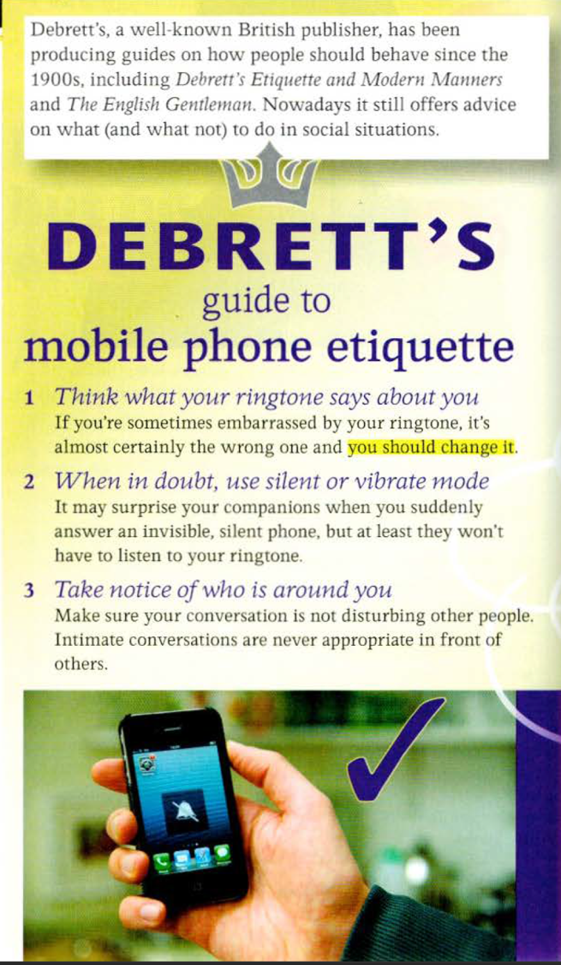
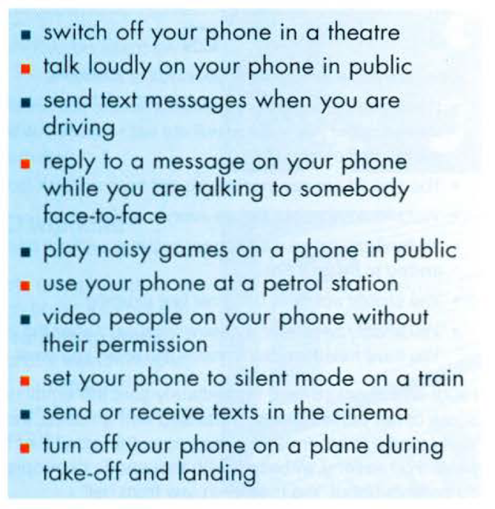
4B Reading

Slide 11
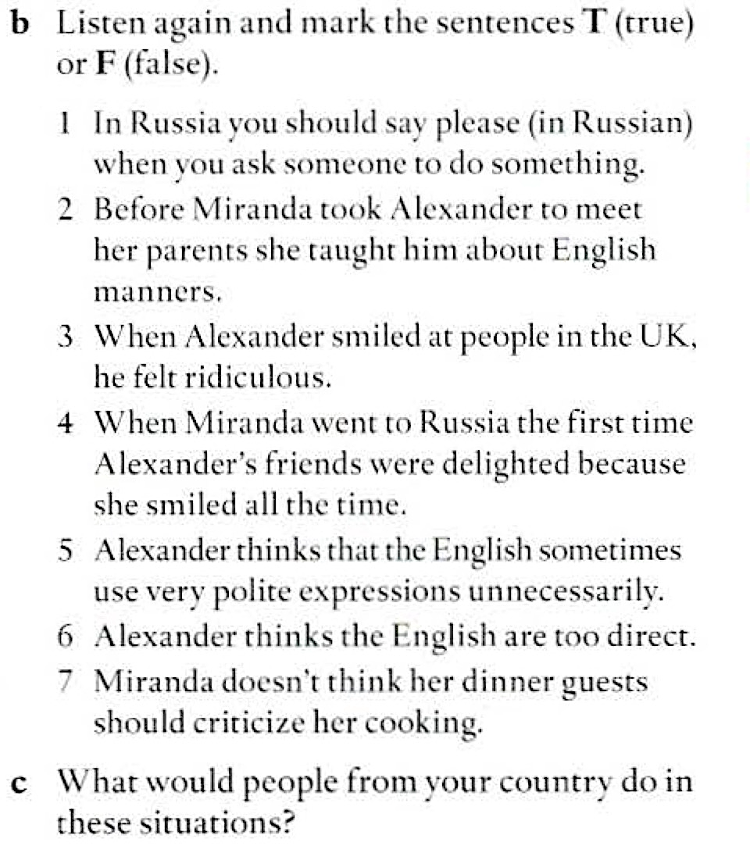
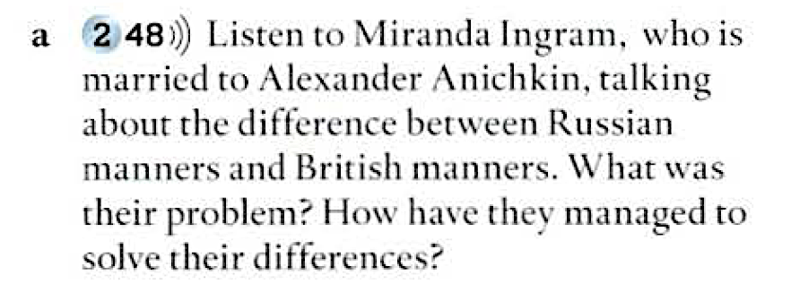
4B Listening

Slide 12
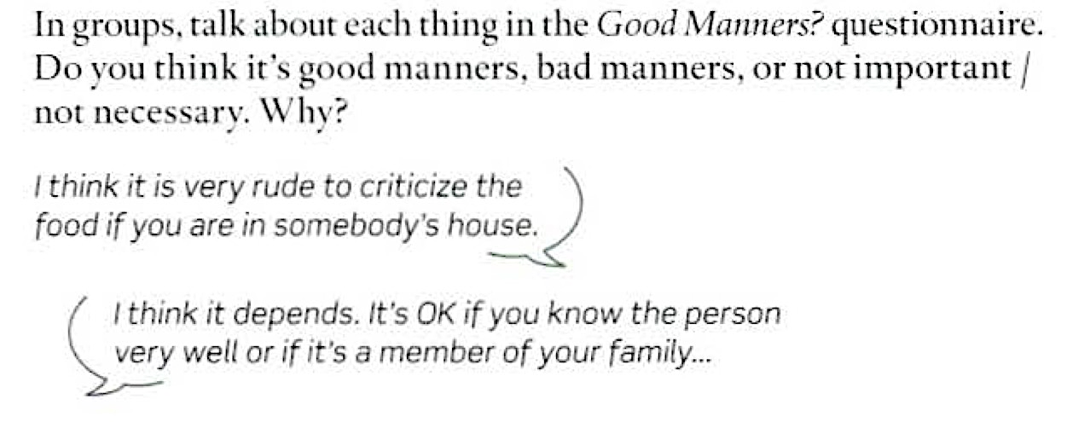
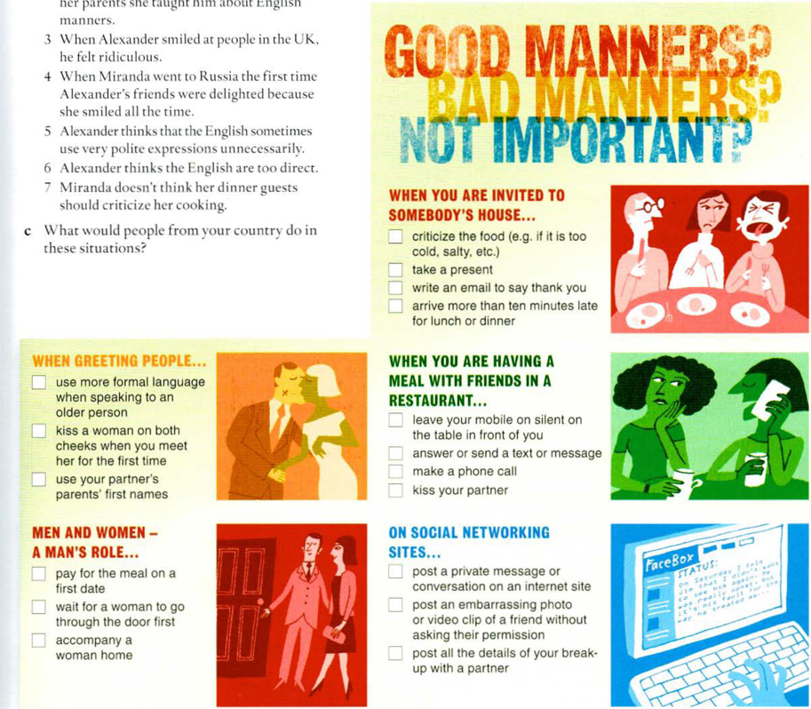
4B Speaking

