Slide 1
Anglický
jazyk
Bc. Zuzana Slavíková

Slide 2
Dnešní lekce

Slide 3
Obsah lekce
5B
Grammar | 05
Pronunciation | 06
Vocabulary | 07
Reading | 08
Listening | 09
Speaking | 10
Practical English | 11

Slide 4
5B Grammar
Grammar Bank; p. 141

Slide 5
5B Pronunciation

Slide 6
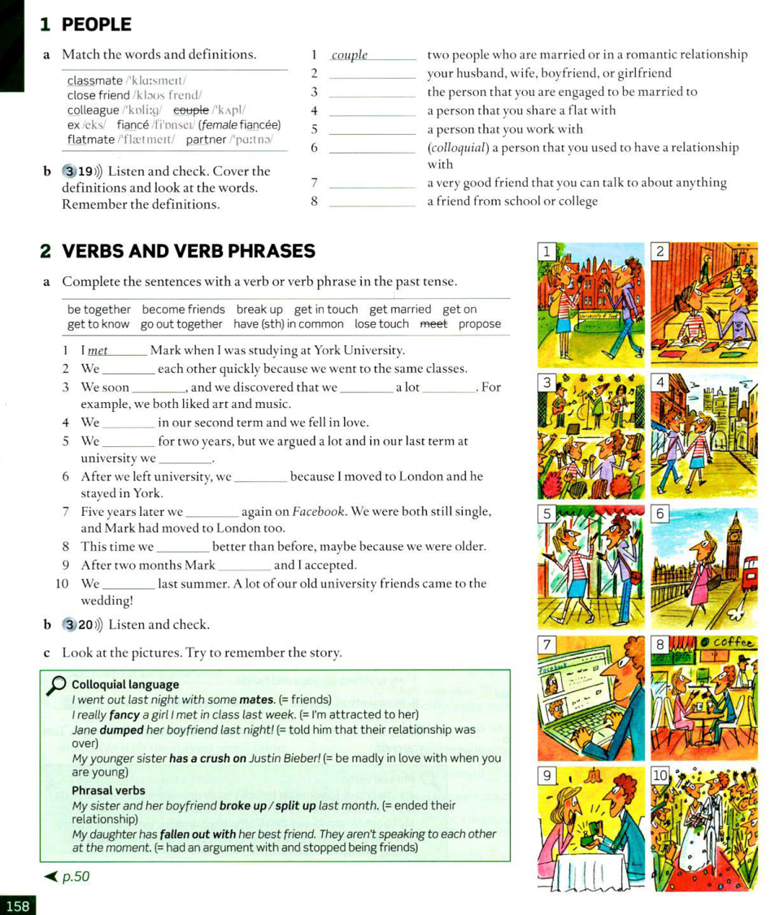
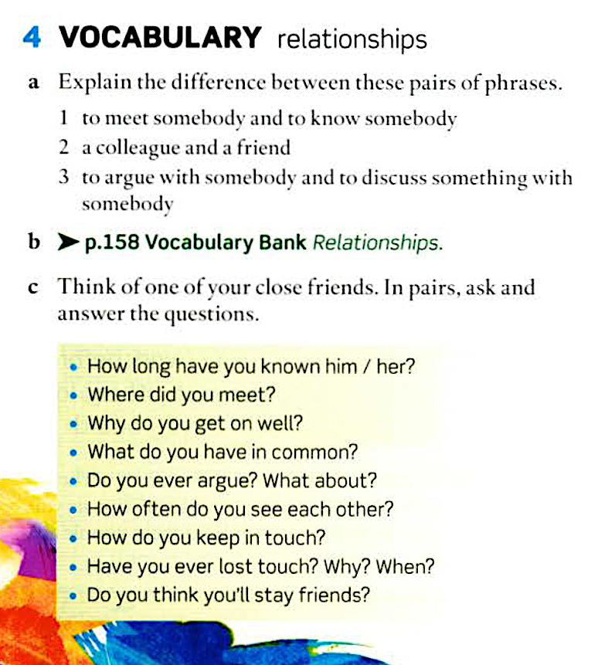
5B Vocabulary
Vocabulary Bank; p. 158

Slide 7
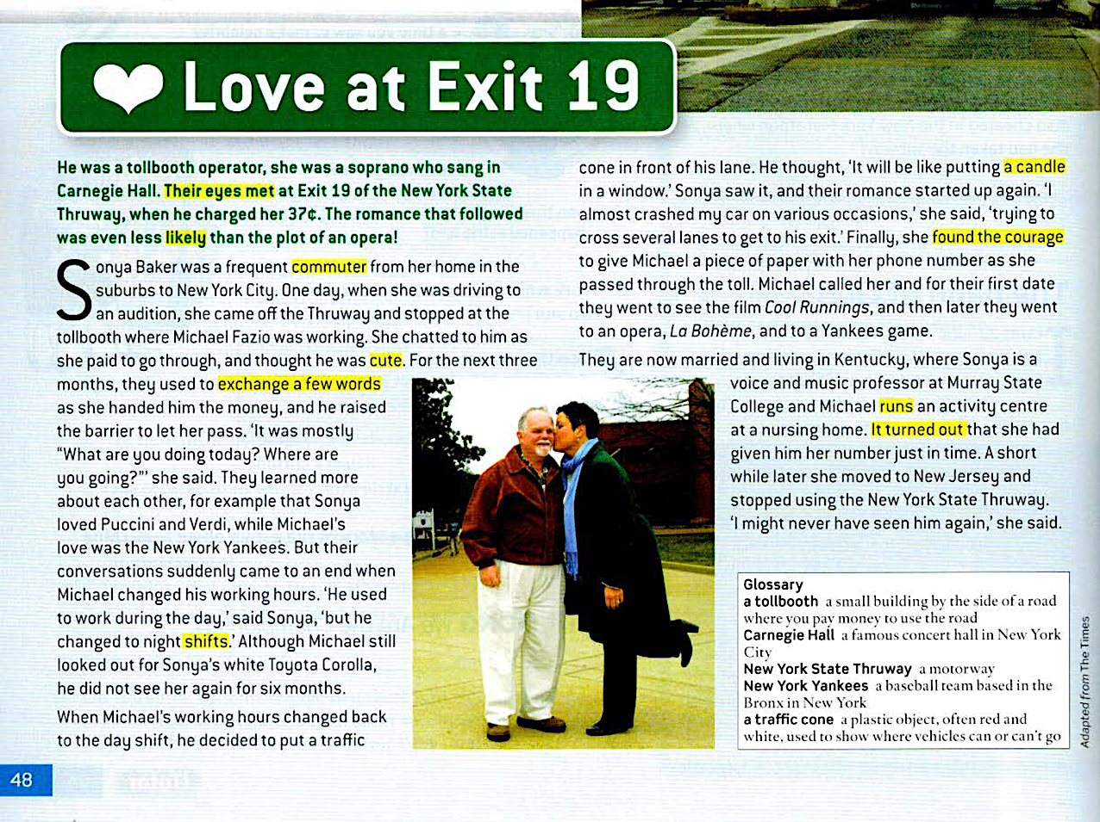
5B Reading

Slide 8
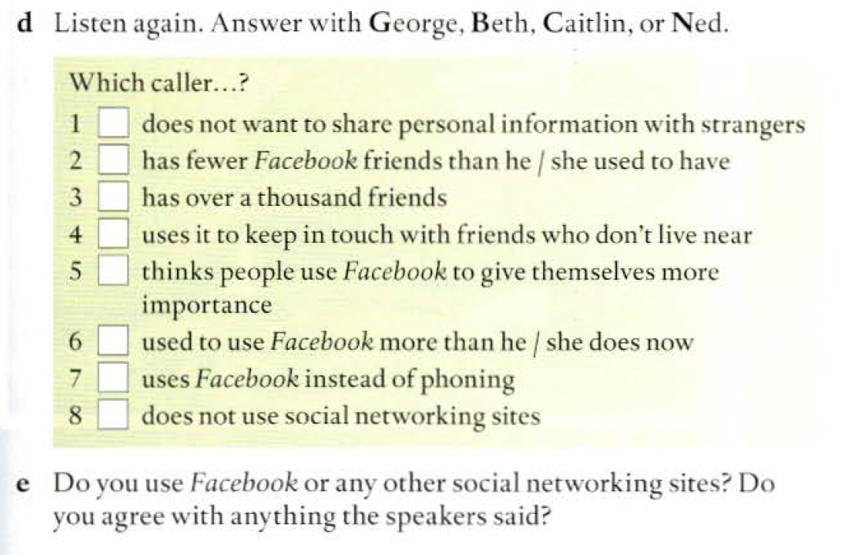
5B Listening

Slide 9
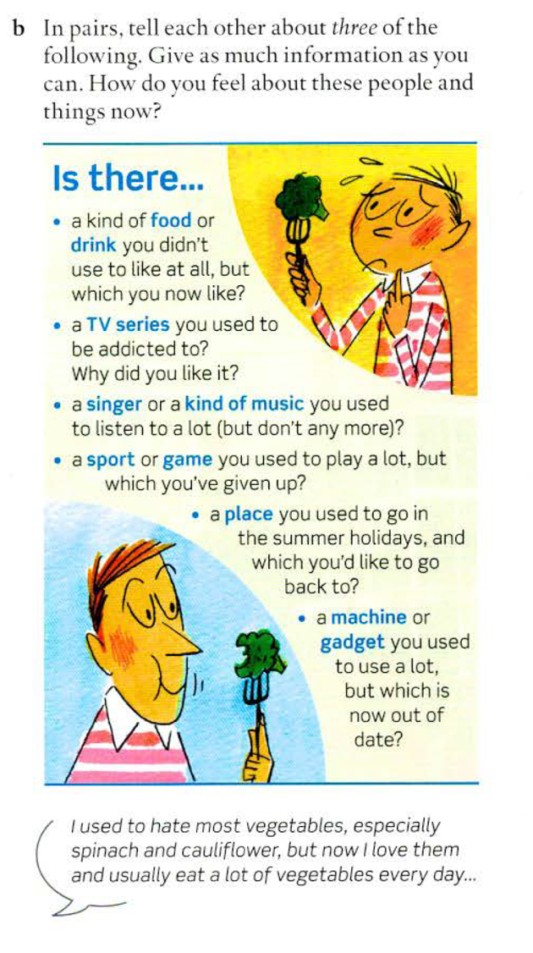
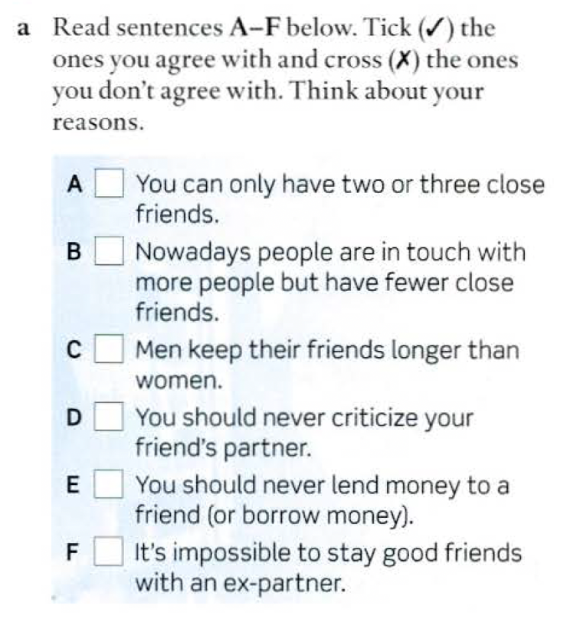
5B Speaking

Slide 10
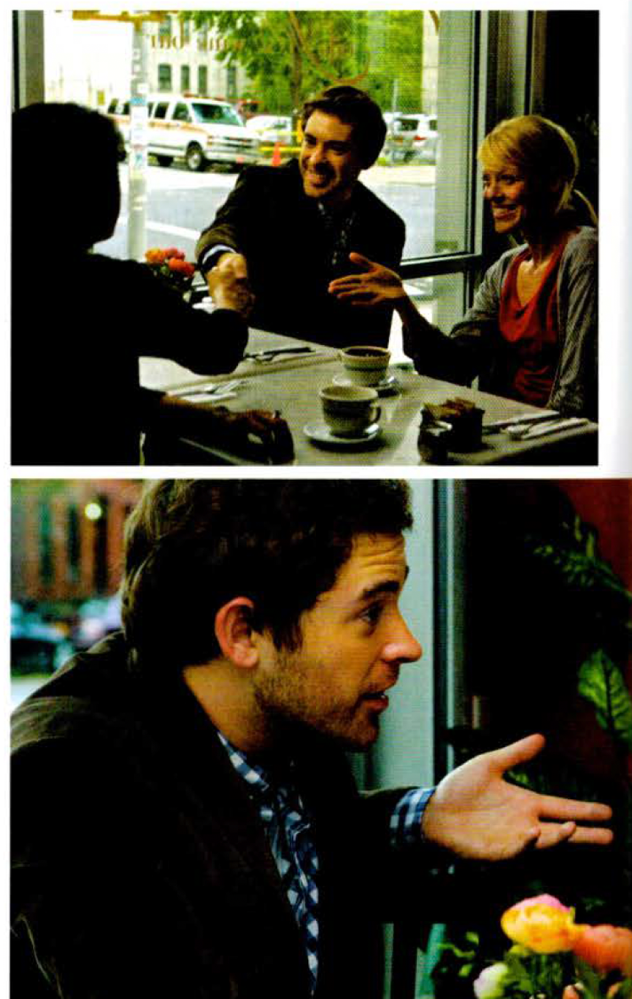
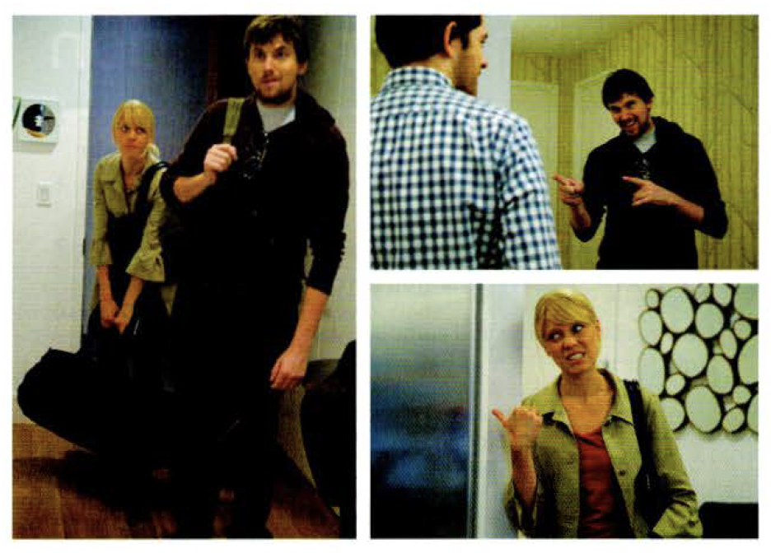
Practical English: episode 3

