Slide 1
Anglický
jazyk
Bc. Zuzana Slavíková

Slide 2
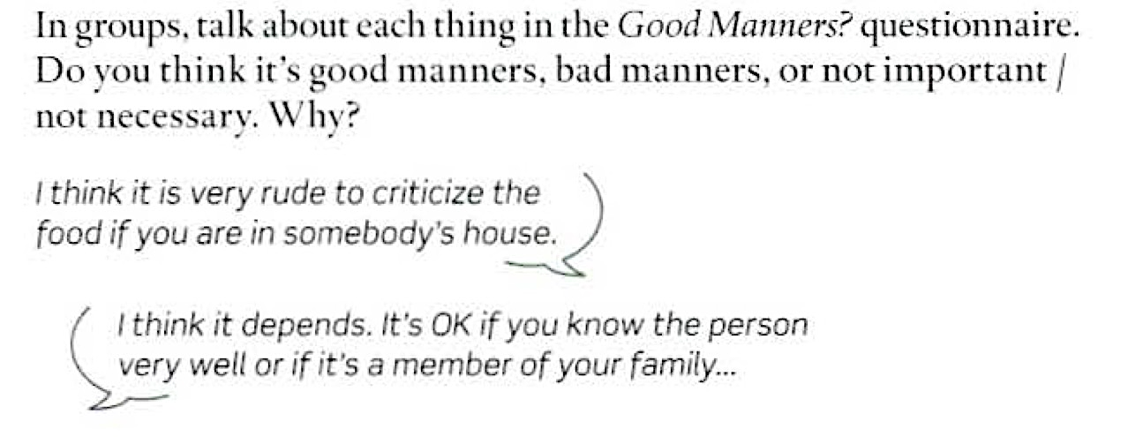
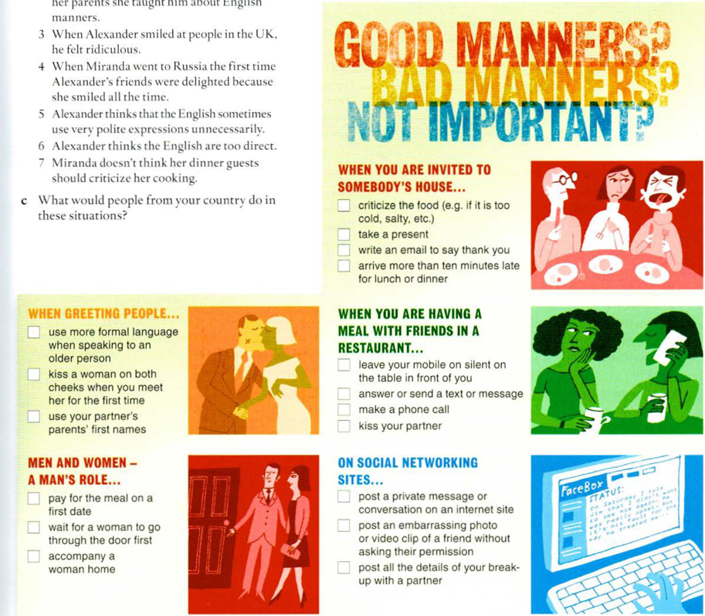
4B Speaking

Slide 3
Dnešní lekce

Slide 4
Obsah lekce
5A
Grammar: past tenses | 05
Pronunciation | 06
Vocabulary | 07
Reading | 08
Listening | 09
Speaking | 10
Writing | 11

Slide 5
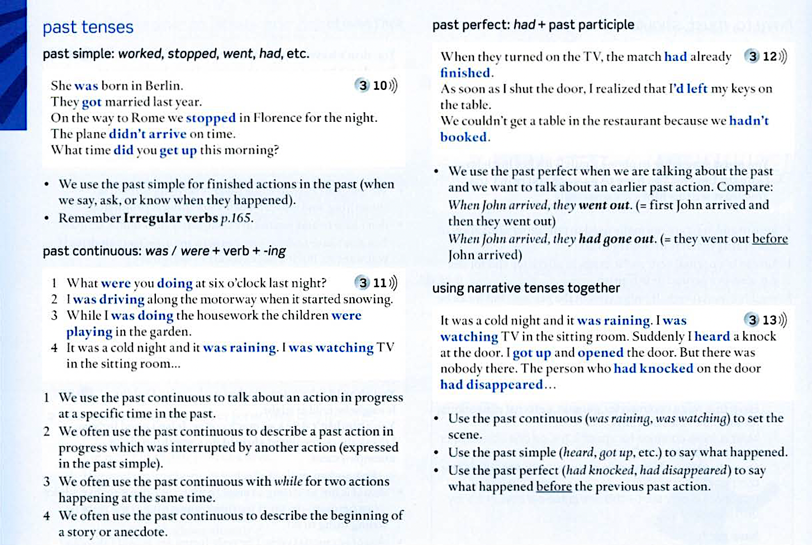
5A Grammar
Grammar Bank; p. 140

Slide 6
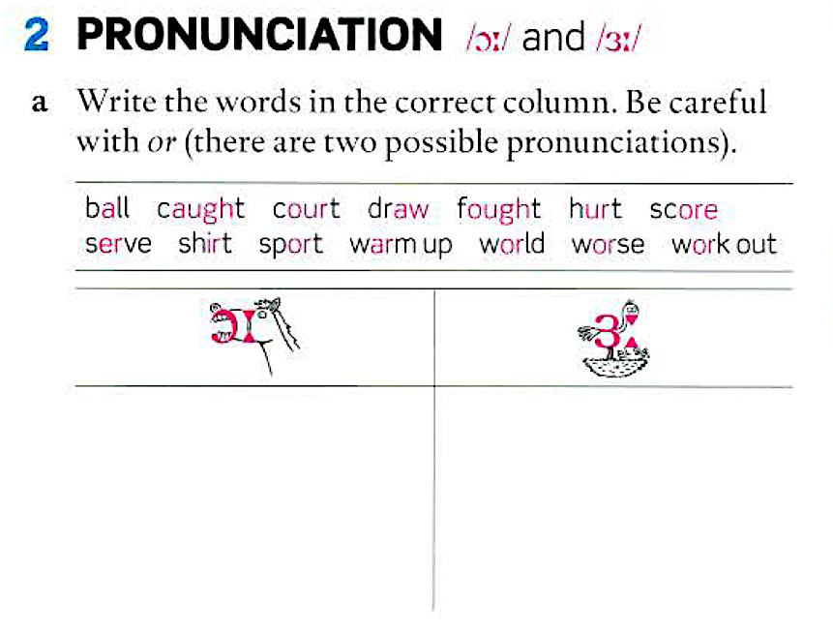
5A Pronunciation

Slide 7
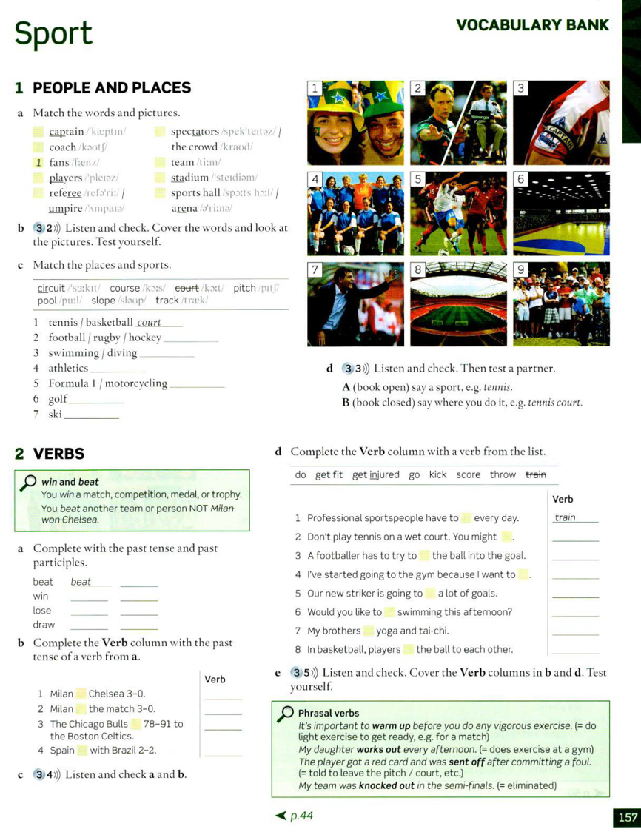
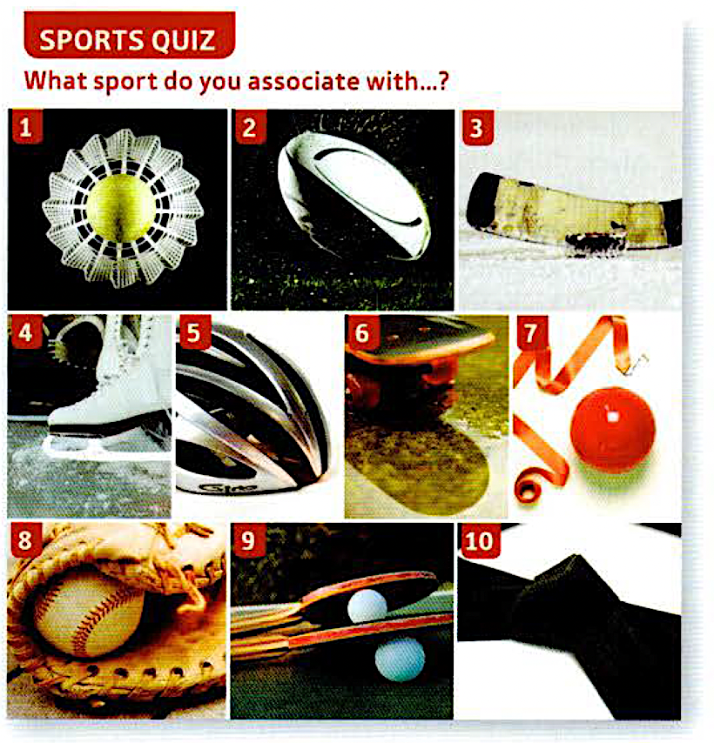
5A Vocabulary
Vocabulary Bank; p. 157

Slide 8
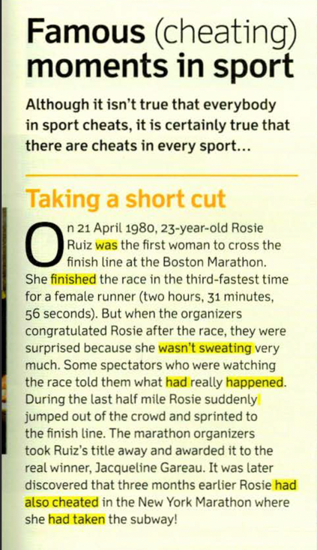
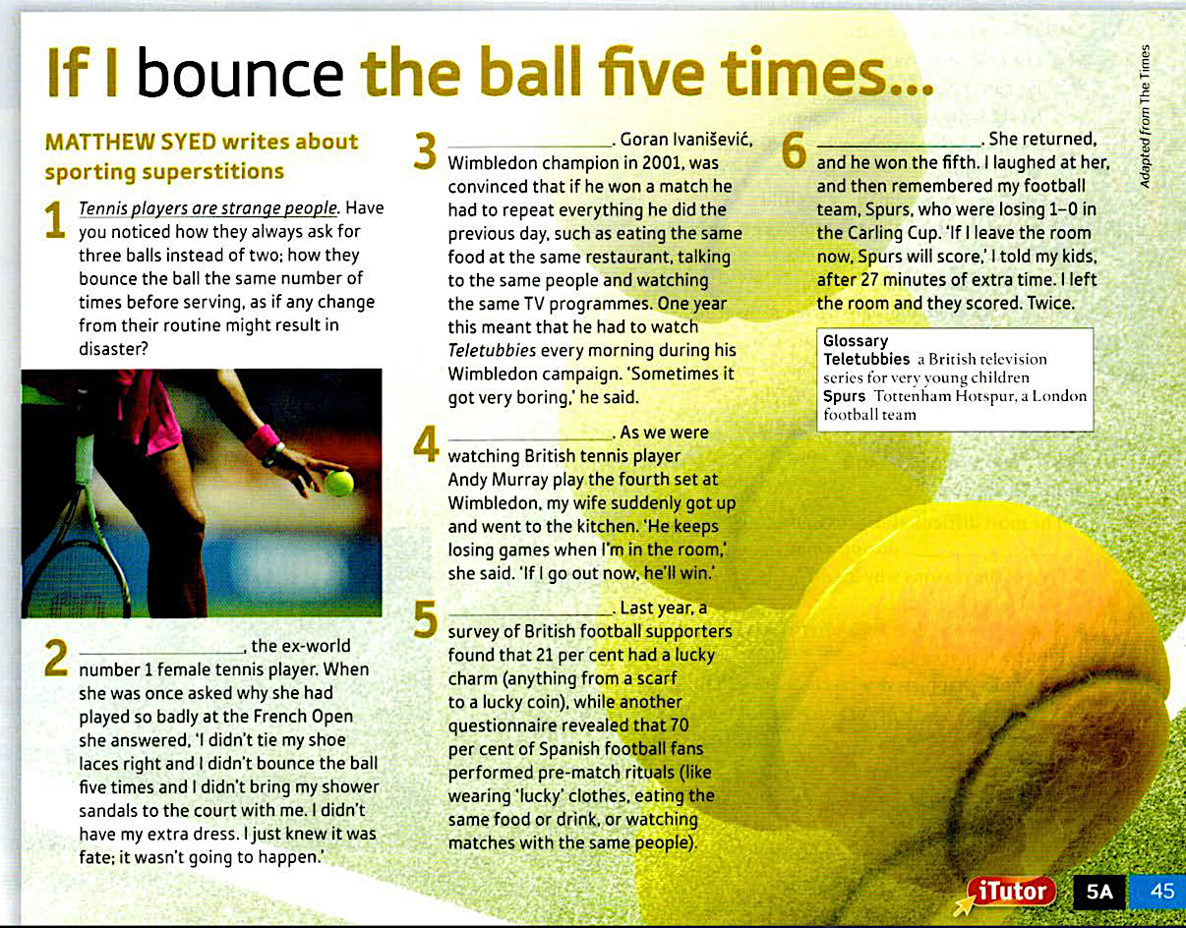
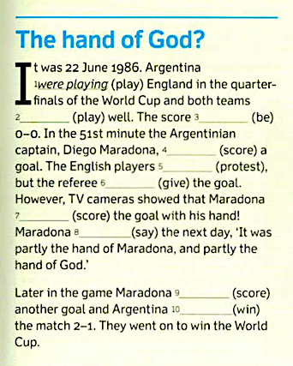
5A Reading

Slide 9
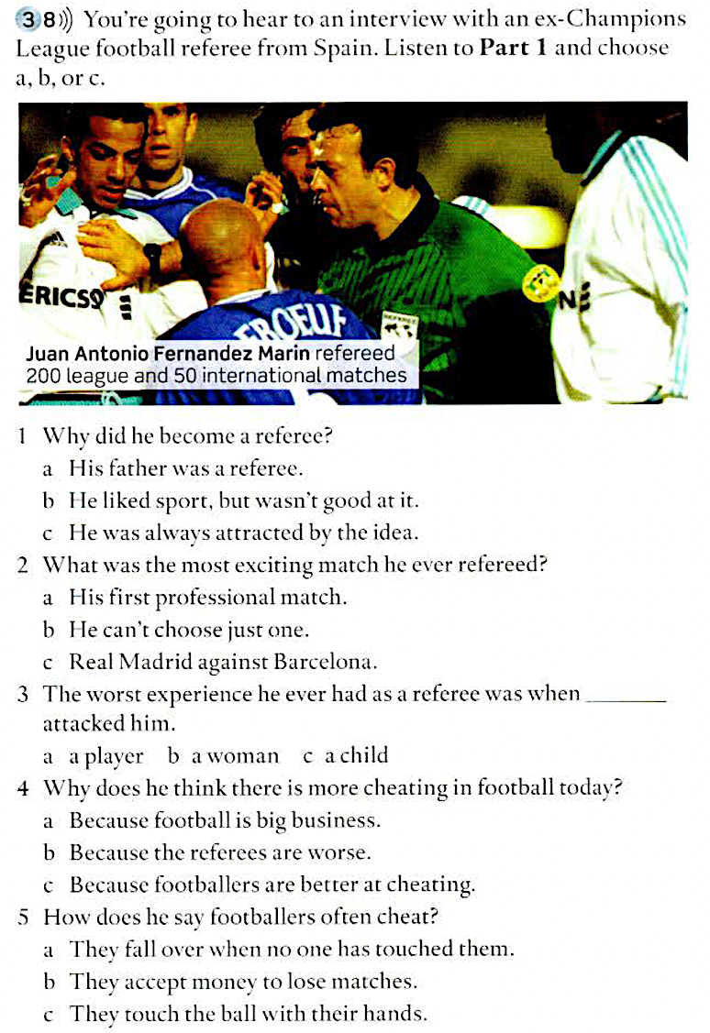
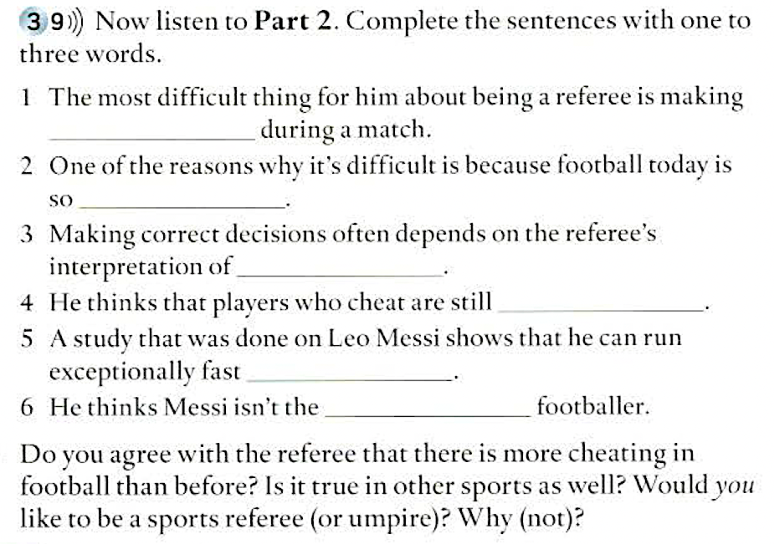
5A Listening

Slide 10
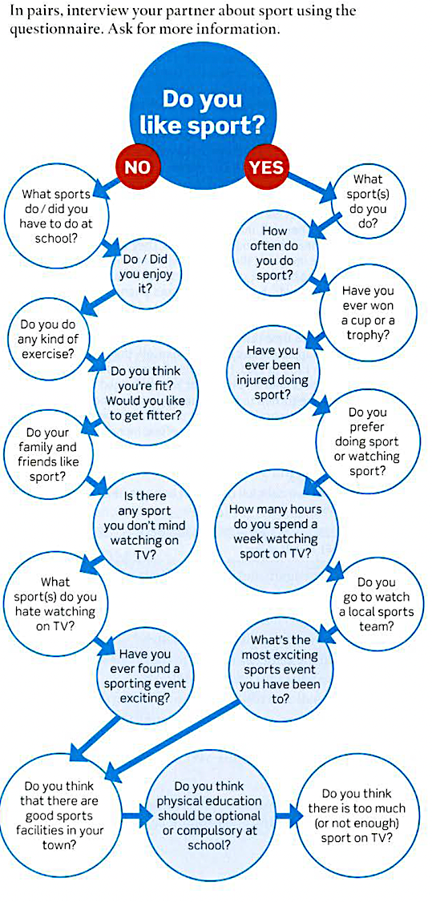
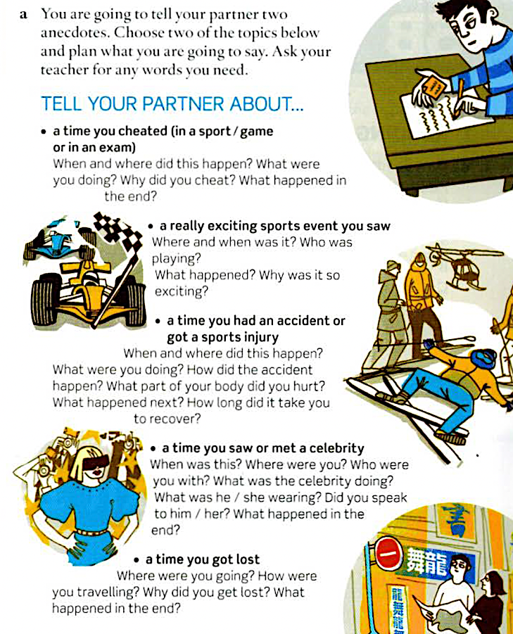
5A Speaking

Slide 11
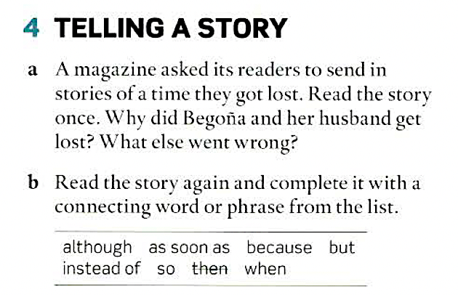
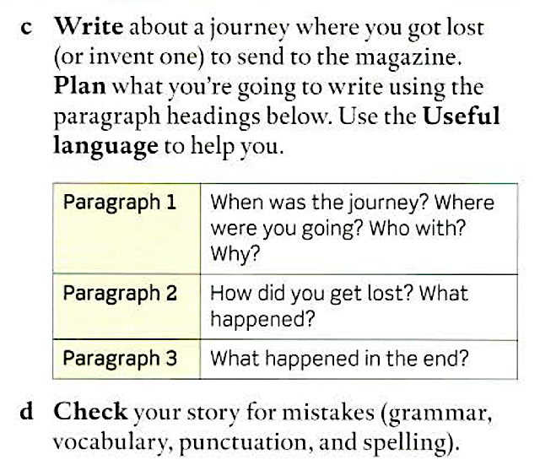
5A Writing
p. 116

