Slide 1
Anglický
jazyk
Bc. Zuzana Slavíková

Slide 2
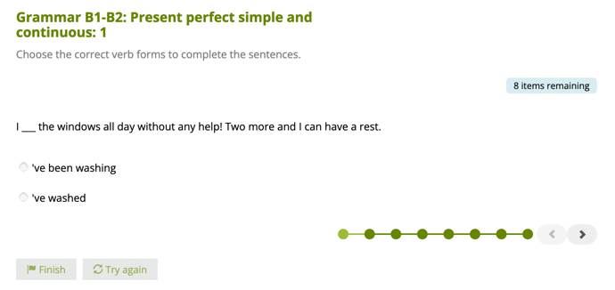
Souhrn minulé lekce
present perfect: simple vs. continuous
Which words in a sentence are stressed? Why?
1&2 Revise and Check: Student’s Book p. 22-23

Slide 3
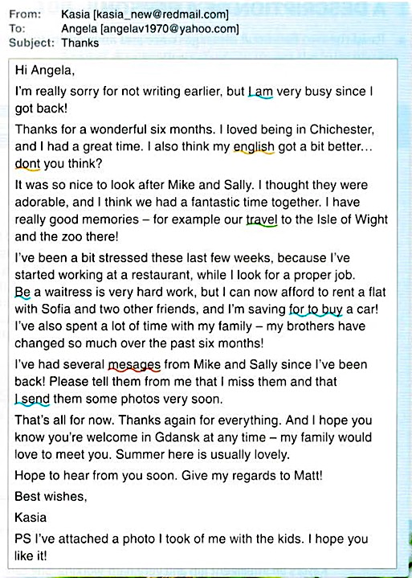
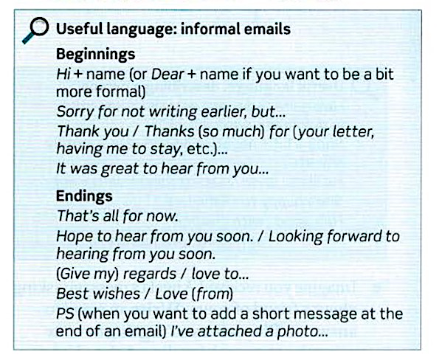
2B Writing: an informal e-mail
Student’s Book; p. 114

Slide 4
Dnešní lekce

Slide 5
Obsah lekce
3A
Grammar: comparatives | 06
Grammar: superlatives | 07
Grammar: pop quiz | 08
Pronunciation: linking | 09
Vocabulary: transport | 10
Reading | 11
Listening | 12
Speaking | 13

Slide 6
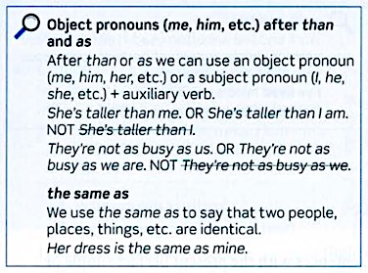
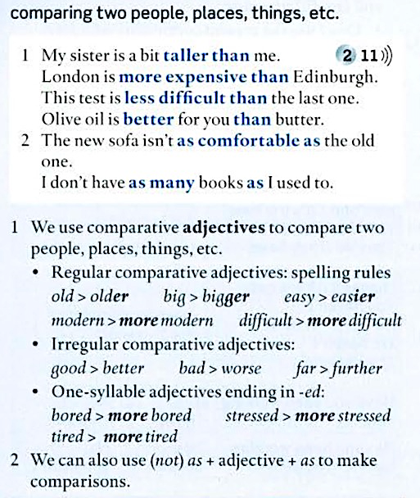
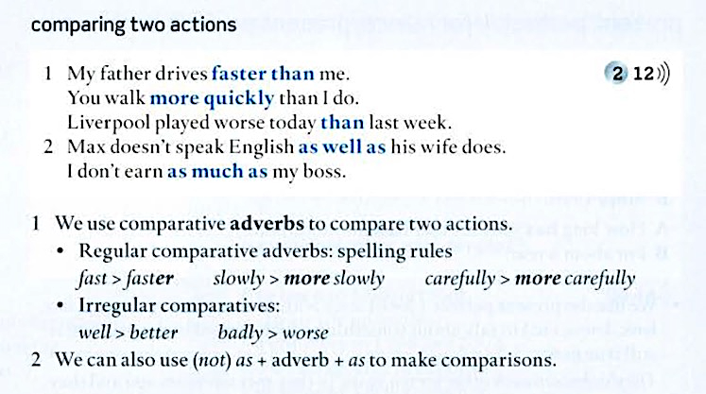
3A Grammar: comparatives
Student’s Book p. 136

Slide 7
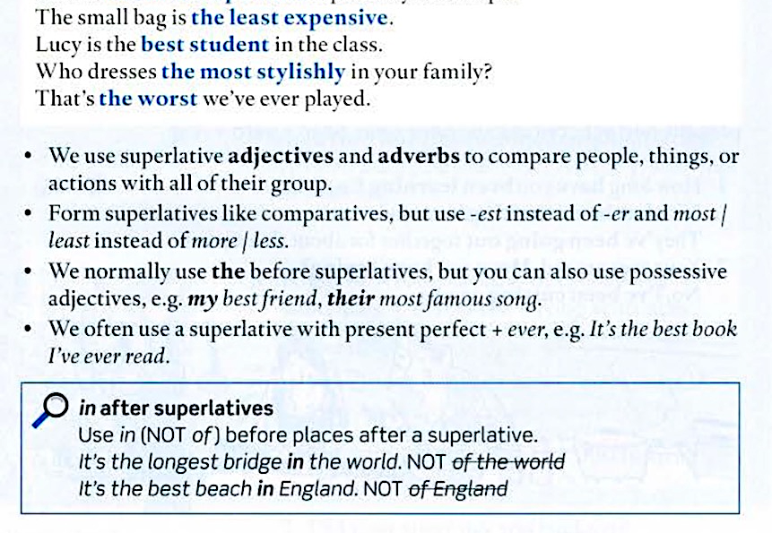
3A Grammar: superlatives

Slide 8
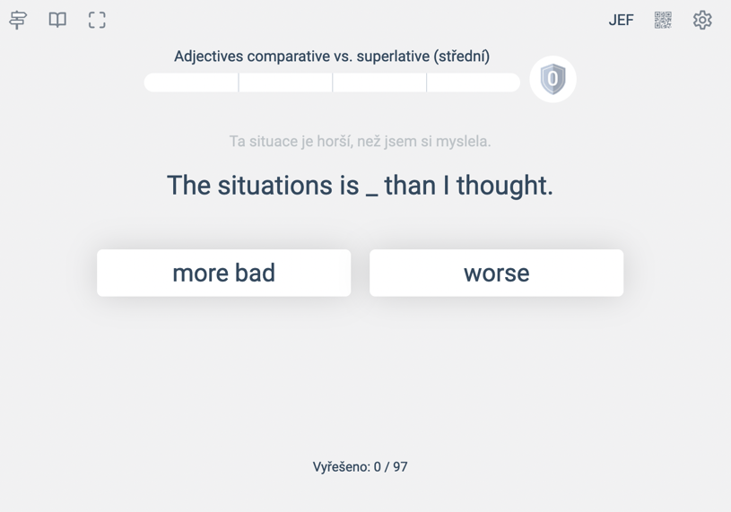
3A Grammar: pop quiz

Slide 9
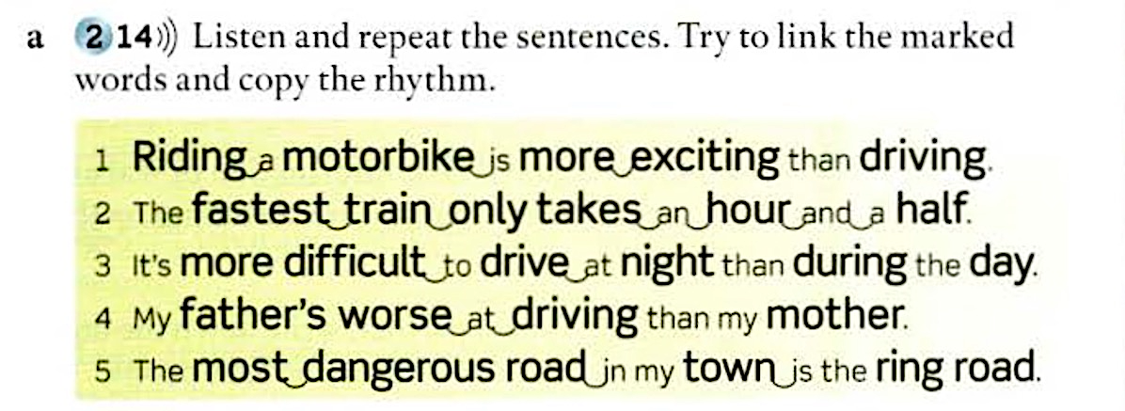
3A Pronunciation: linking
https://www.youtube.com/watch?v=iuh6_d_pBaE

Slide 10
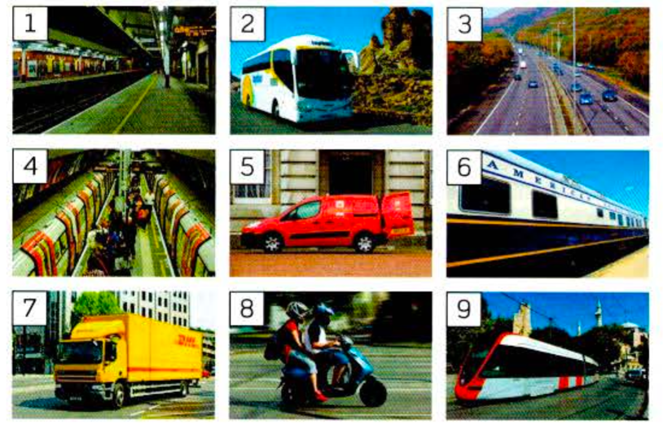
3A Vocabulary: transport
Student’s Book p. 155

Slide 11
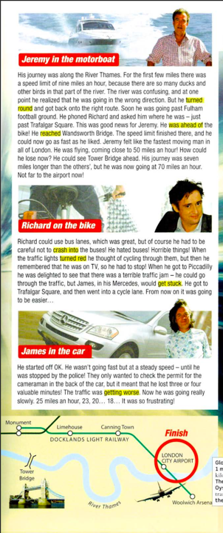
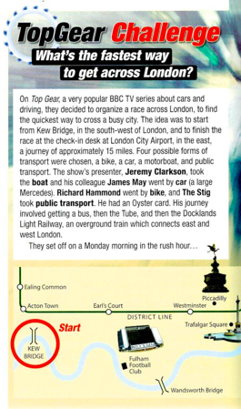
3A Reading
Student’s Book p. 24-25

Slide 12
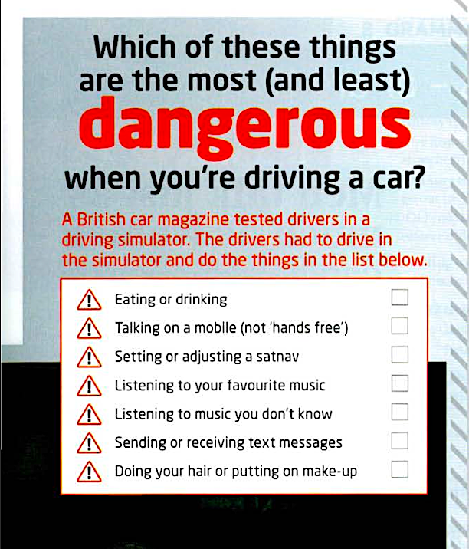
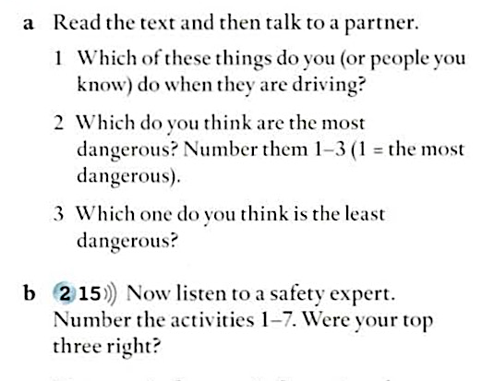
3A Listening

Slide 13
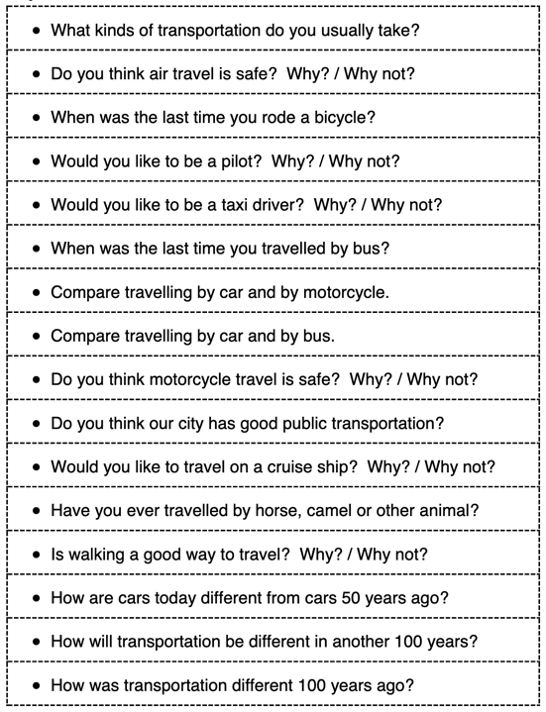
3A Speaking

