Slide 1
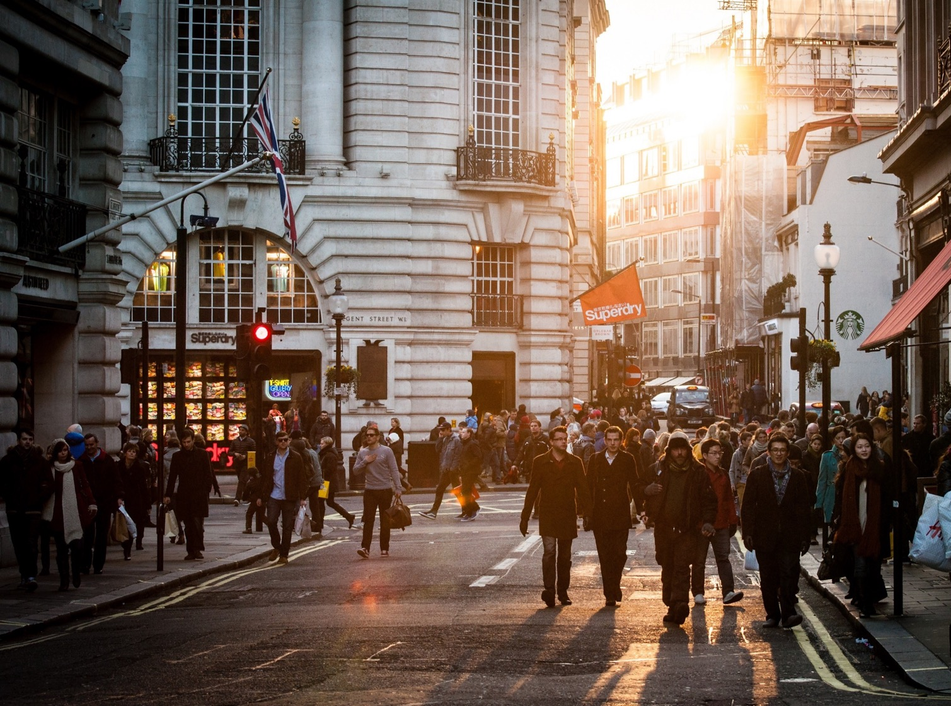
Anglický
jazyk
Bc. Zuzana Slavíková

Slide 2
Souhrn minulé lekce
Homework check
Articles
a/an
the
zero article
Practical English: Episode 2 (part 2)

Slide 3
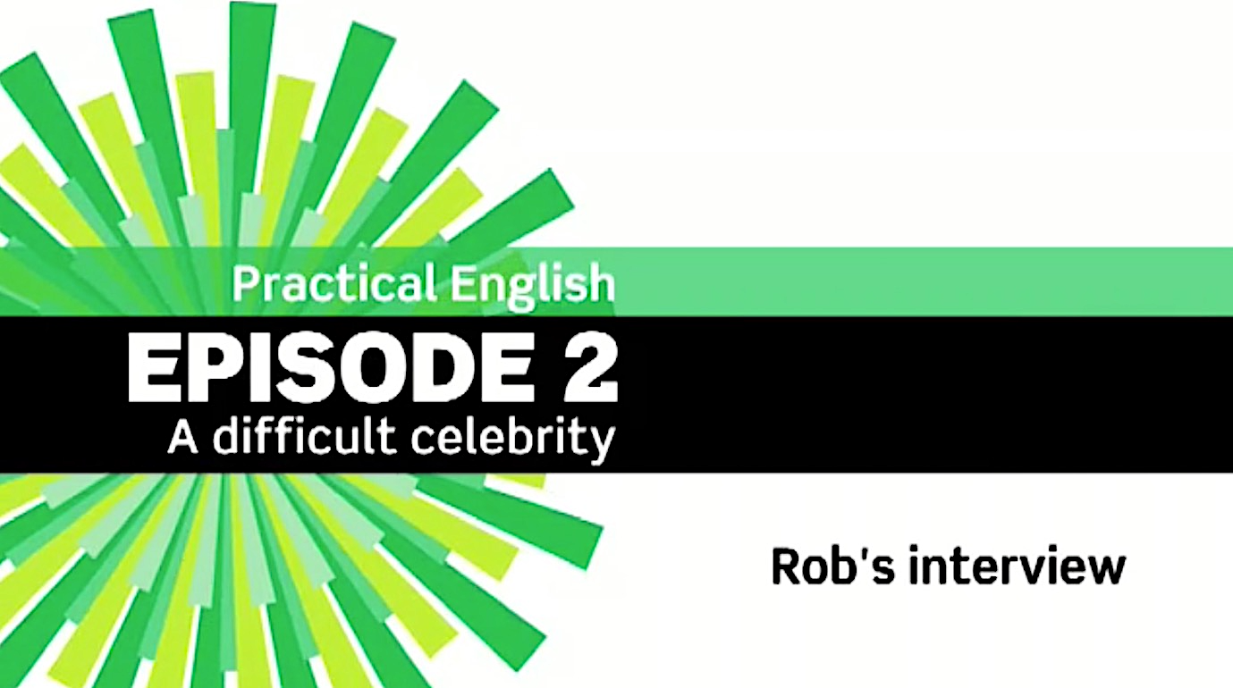
Practical English: episode 2

Slide 4
Dnešní lekce

Slide 5
Obsah lekce
4A
Grammar: can, could, be able to | 05
Grammar: pop quiz | 06
Pronunciation | 07
Vocabulary | 08
Reading | 09
Speaking | 10

Slide 6
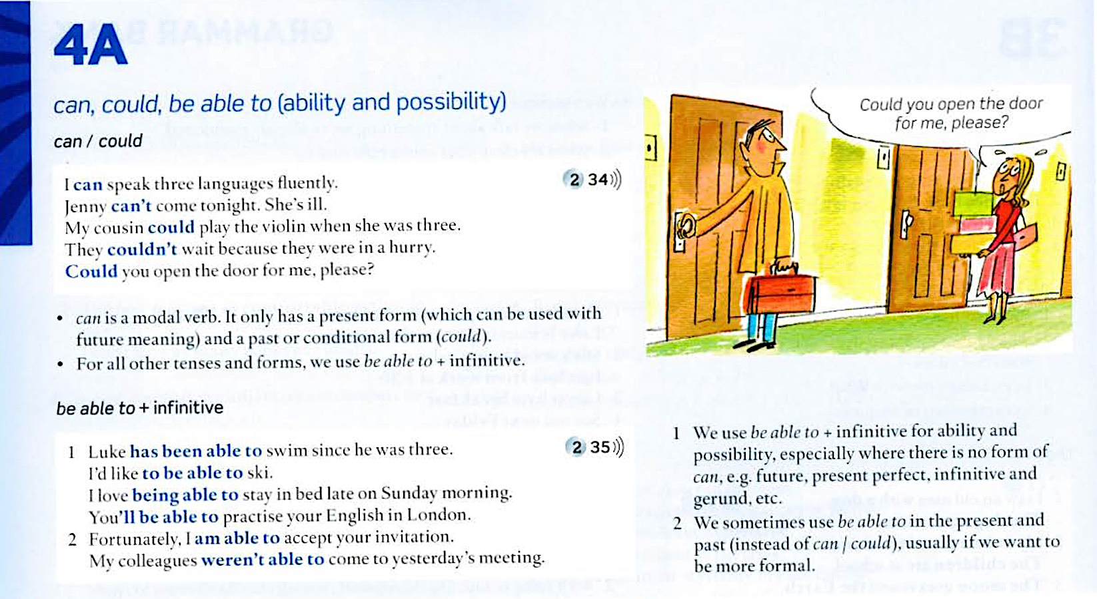
4A Grammar: can, could, be able to
Student’s Book: p. 138

Slide 7
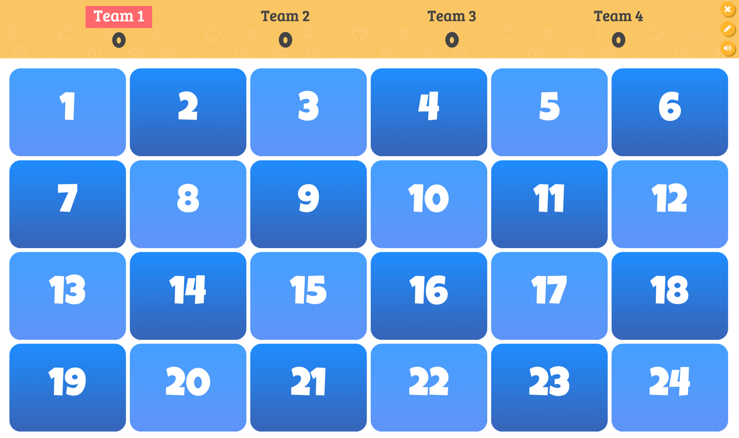
4A Grammar: pop quiz

Slide 8
4A Pronunciation

Slide 9
4A Vocabulary

Slide 10
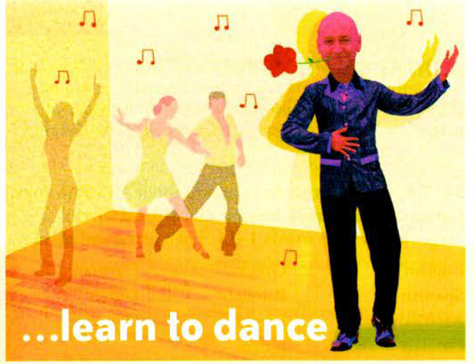
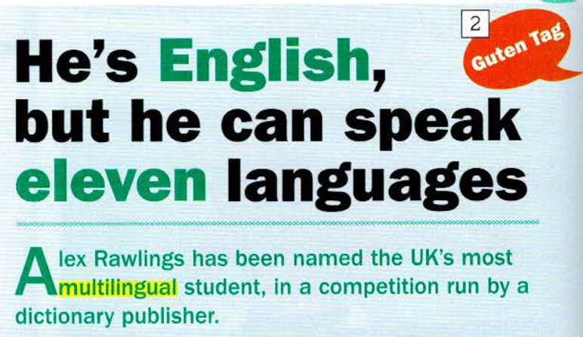
4A Reading

Slide 11
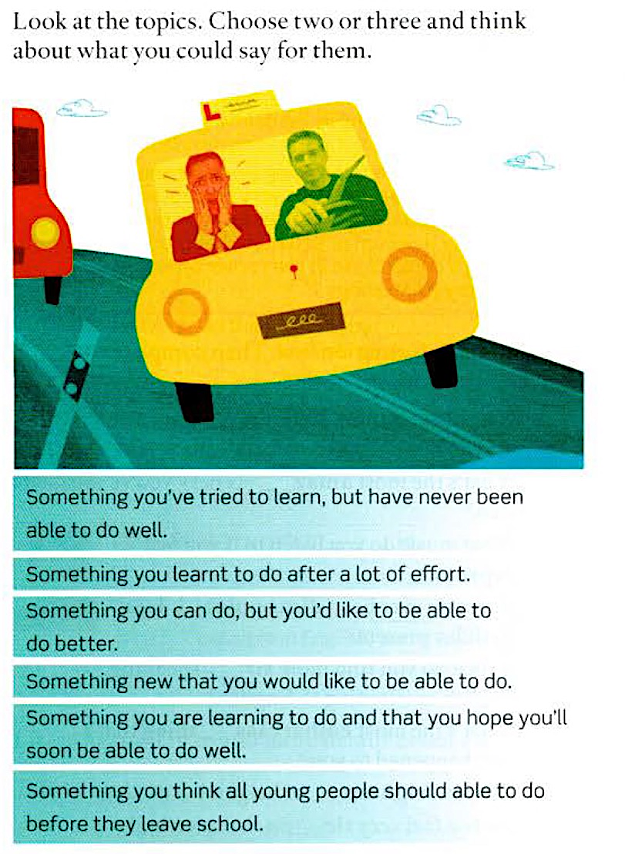
4A Speaking

